Slide 1
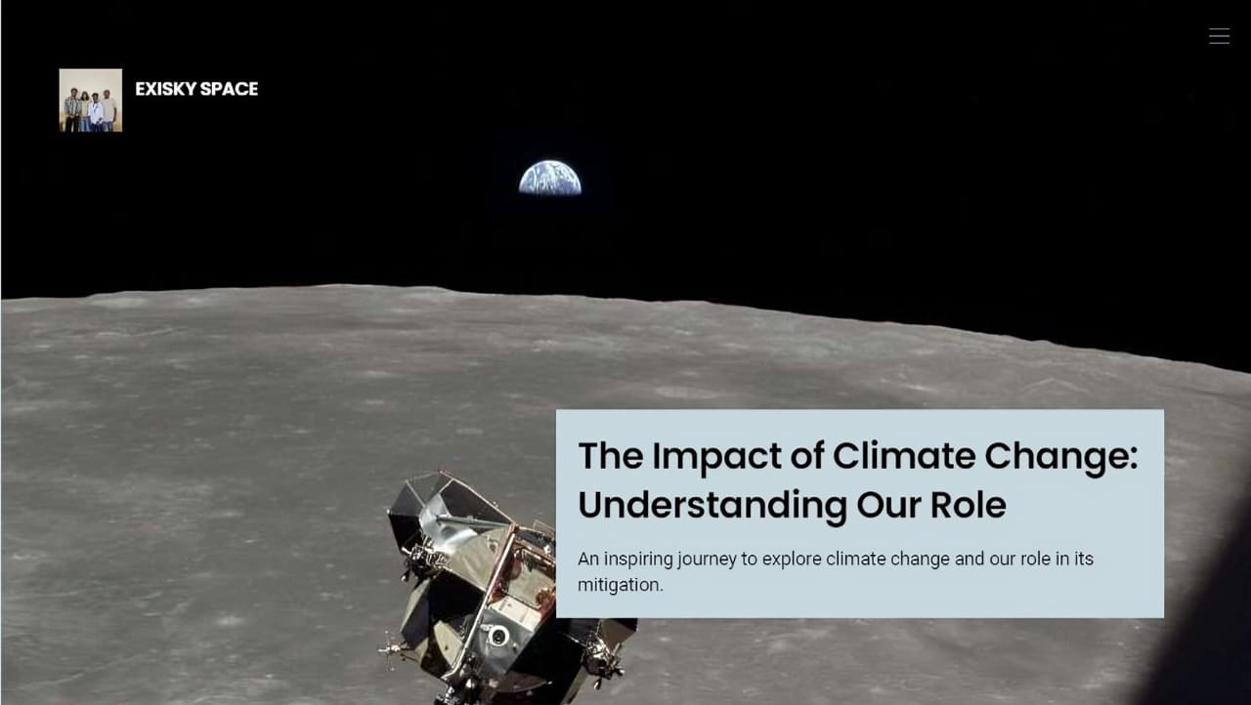
PROJECT DEMO

Slide 2
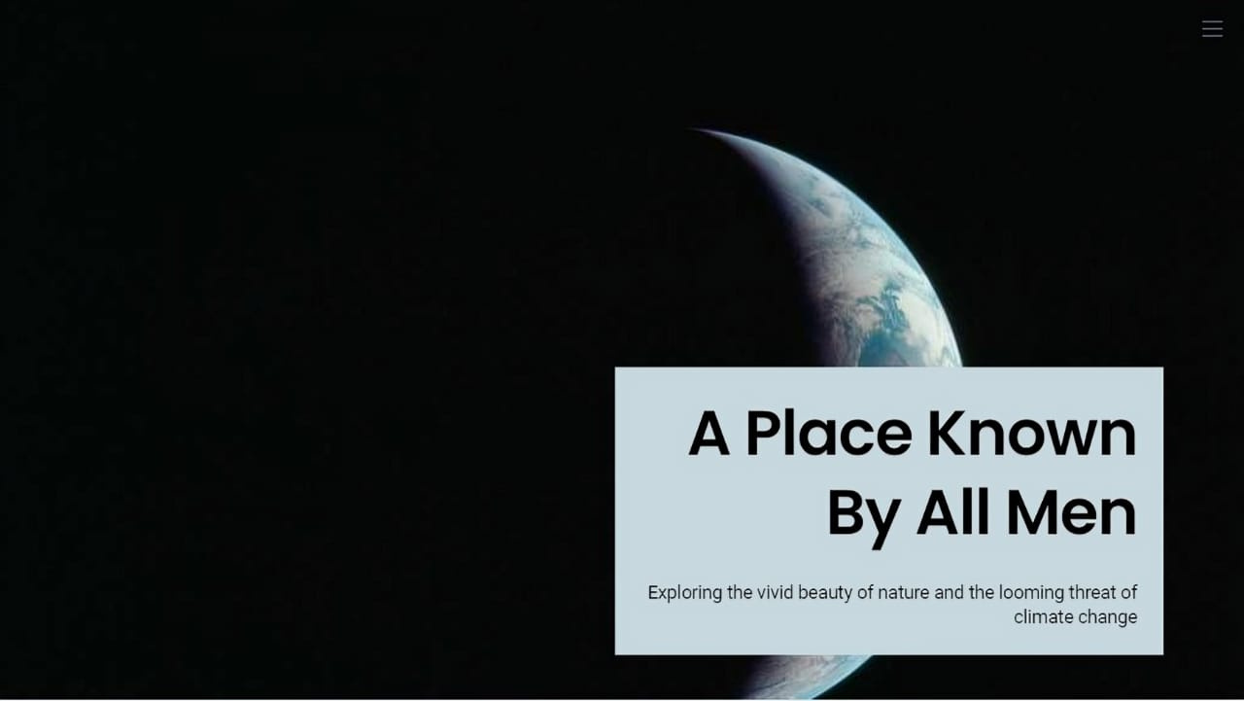
PROJECT DEMO

Slide 3
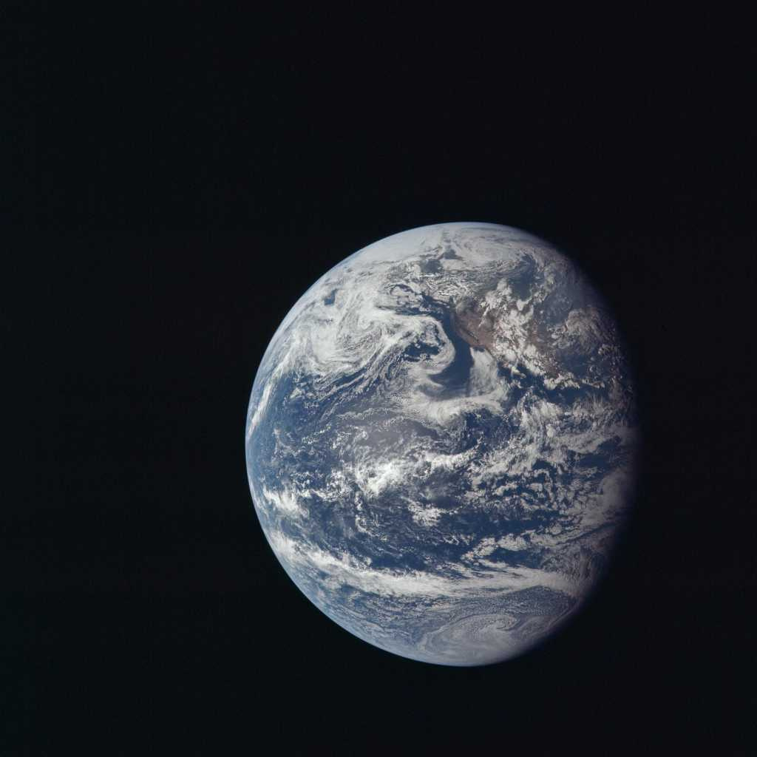
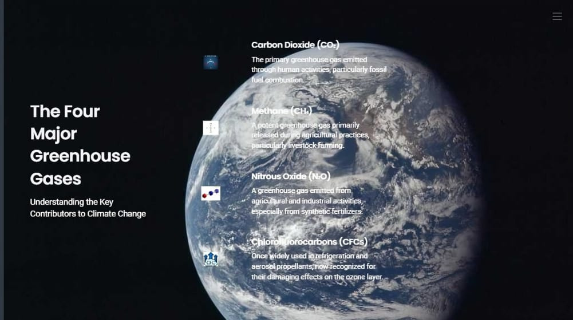
PROJECT DEMO

Slide 4
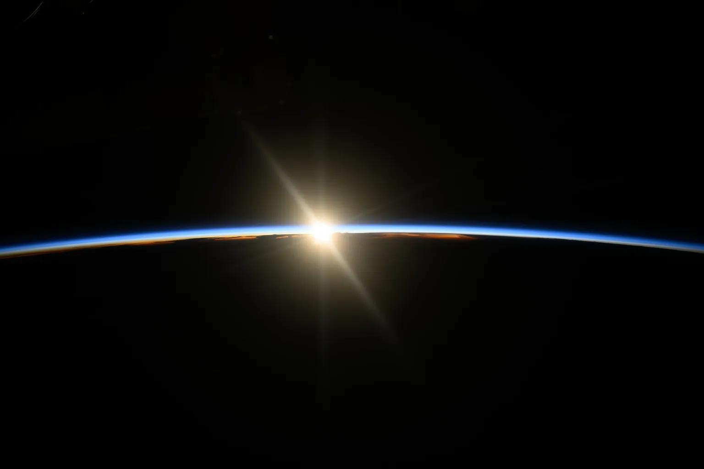
PROJECT DEMO
Methane (CH₄)
Produced during the breakdown of organic matter in landfills, agriculture (especially from livestock), and natural gas production.
Carbon Dioxide (CO₂)
Released from burning fossil fuels (coal, oil, natural gas), deforestation, and land-use changes.

Slide 5
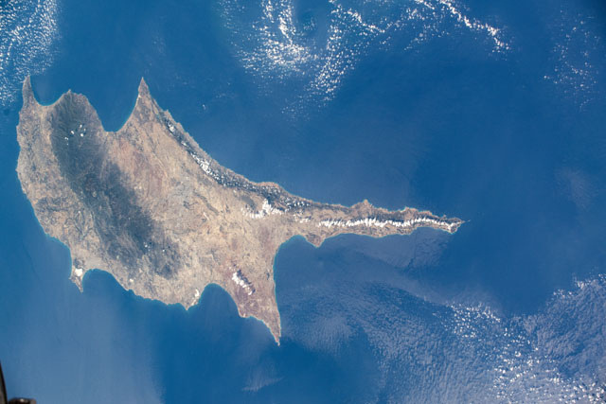
PROJECT DEMO
Nitrous Oxide (N₂O)
Chlorofluorocarbons (CFCs)
Emitted from agricultural and industrial activities, as well as during combustion of fossil fuels and solid waste.
Historically used in refrigeration, air conditioning, foam-blowing agents, and aerosol propellants.

Slide 6
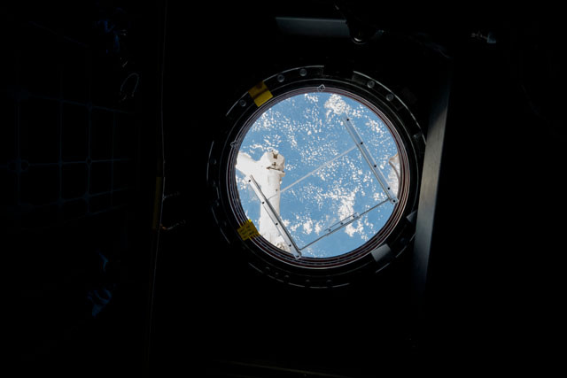
PROJECT DEMO
Presented by
EXISKY SPACE
OJES
ABHINAV
AL AMEEN
BINJU

